Slide 1

v
DevOps
Suresh
July 05, 2022

Slide 2
Contents
Containers
Vm vs Docker
What is Docker
Dockerfiles
Components of Docker
Advanced Docker Concepts
Advantages & Trends
Basic Docker Commands

Slide 3
Containers
The industry standard today is to use Virtual Machines (VMs) to run software applications. VMs run applications inside a guest Operating System, which runs on virtual hardware powered by the server’s host OS.
However, Containers take a different approach by leveraging the low-level mechanics of the host operating system, containers provide most of the isolation of virtual machines at a fraction of the computing power.

Slide 4
Why use Containers?
Containers offer a logical packaging mechanism in which applications can be abstracted from the environment in which they actually run. This decoupling allows container-based applications to be deployed easily and consistently, regardless of whether the target environment is a private data center, the public cloud, or even a developer’s personal laptop. This gives developers the ability to create predictable environments that are isolated from the rest of the applications and can be run anywhere.

Slide 5
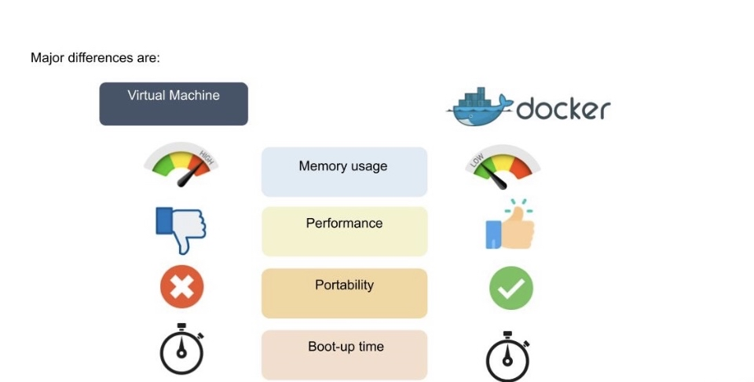
VM vs Docker

Slide 6
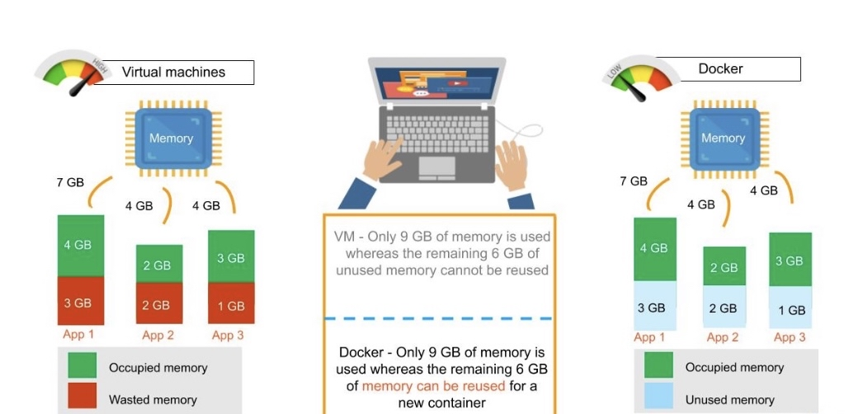
Memory chain

Slide 7
What is Docker
Docker is a tool that allows developers, sys-admins etc. to easily deploy their applications in a sandbox (called containers) to run on the host operating system i.e. Linux.

Slide 8
Dockerfile
A Dockerfile is a simple text file that contains a list of commands that the Docker client calls while creating an image. It's a simple way to automate the image creation process. The best part is that the commands you write in a Dockerfile are almost identical to their equivalent Linux commands. This means you don't really have to learn new syntax to create your own dockerfiles.

Slide 9
Components of Docker
There are four components that we will discuss
Docker client and server
Docker image
Docker registry
Docker container

Slide 10
Docker Client and Server
This is a command-line-instructed solution in which you would use the terminal on your Mac or Linux system to issue commands from the Docker client to the Docker daemon. The communication between the Docker client and the Docker host is via a REST API. You can issue similar commands, such as a Docker Pull command, which would send an instruction to the daemon and perform the operation by interacting with other components (image, container, registry).

Slide 11
Docker image
The Docker image is built within the YAML file and then hosted as a file in the Docker registry. The image has several key layers, and each layer depends on the layer below it. Image layers are created by executing each command in the Dockerfile and are in the read-only format. You start with your base layer, which will typically have your base image and your base operating system, and then you will have a layer of dependencies above that. These then comprise the instructions in a read-only file that would become your Dockerfile.

Slide 12
Docker registry
The Docker registry is where you would host various types of images and where you would distribute the images from. The repository itself is just a collection of Docker images, which are built on instructions written in YAML and are very easily stored and shared. You can give the Docker images name tags so that it’s easy for people to find and share them within the Docker registry

Slide 13
Docker container
The Docker container is an executable package of applications and its dependencies bundled together; it gives all the instructions for the solution you’re looking to run. It’s really lightweight due to the built-in structural redundancy. The container is also inherently portable. Another benefit is that it runs completely in isolation.

Slide 14
Advanced Docker Components
In the Docker ecosystem, however, there are a bunch of other open-source tools which play very nicely with Docker. A few of them are -
Docker Compose - A tool for defining and running multi-container Docker applications.
Docker Swarm - A native clustering solution for Docker
Docker Machine - Create Docker hosts on your computer, on cloud providers, and inside your own data center
Kubernetes - Kubernetes is an open-source system for automating deployment, scaling, and management of containerized applications.

Slide 15
Docker Compose
Docker compose is designed for running multiple containers as a single service. It does so by running each container in isolation but allowing the containers to interact with one another. As noted earlier, you would write the compose environments using YAML.
So in what situations might you use Docker compose? An example would be if you are running an Apache server with a single database and you need to create additional containers to run additional services without having to start each one separately. you would write a set of files using Docker compose to do that.

Slide 16
Docker Swarm
Docker swarm is a service for containers that allows IT administrators and developers to create and manage a cluster of swarm nodes within the Docker platform. Each node of Docker swarm is a Docker daemon, and all Docker daemons interact using the Docker API. A swarm consists of two types of nodes: a manager node and a worker node. A manager node maintains cluster management tasks. Worker nodes receive and execute tasks from the manager node.

Slide 17
Advantages of Docker
We can perform rapid deployment using Docker. The environment itself is highly portable and was designed with efficiencies that allow you to run multiple Docker containers in a single environment, unlike traditional virtual machine environments.
The configuration itself can be scripted through a language called YAML, which allows you to describe the Docker environment you want to create. This, in turn, allows you to scale your environment quickly. But probably the most critical advantage these days is security.

Slide 18
Contd…
We have to ensure that the environment we are running is highly secure yet highly scalable, and Docker takes security very seriously. We’ll see it as one of the key components of the agile architecture of the system we’re implementing.

Slide 19
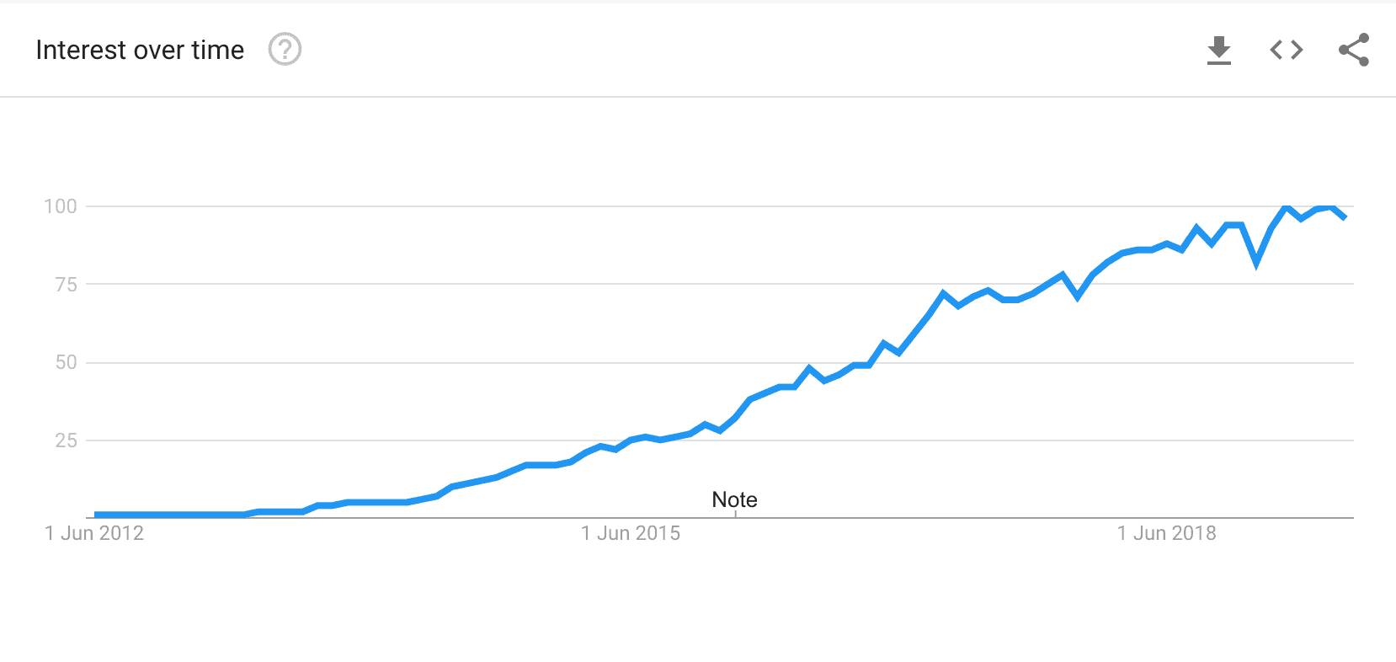
Trend of Docker

Slide 20
Use cases
Due to these benefits, containers (& Docker) have seen widespread adoption. Companies like Google, Facebook, Netflix and Salesforce leverage containers to make large engineering teams more productive and to improve utilization of compute resources. In fact, Google credited containers for eliminating the need for an entire data center.

Slide 21
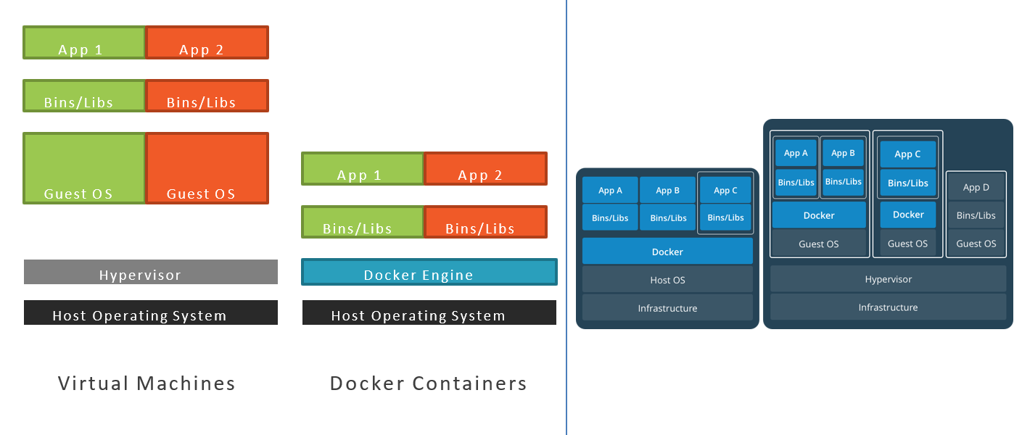
Docker Containers Versus Virtual Machines

Slide 22
Docker vs. Virtual Machine: Which is a Better Choice?
Answer to this so far cannot be ascertained, but depending upon their configurations and advantages we could say that containers are overcoming virtual machines. The famous global researcher Gartner has predicted that by 2023, more than 50% of companies will adopt Docker containers. However, a serverless container like Docker will have a raise in the revenue from a small base of $465.8 million in 2020 to $944 million in 2024.

Slide 23
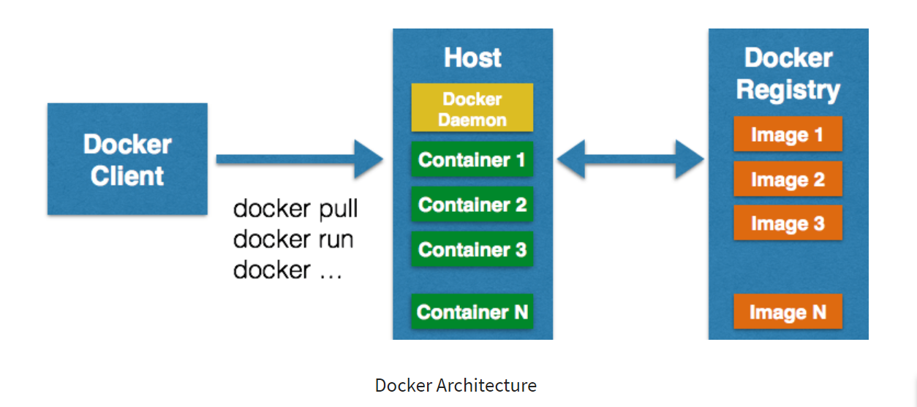
Docker Architecture

